Slide 1






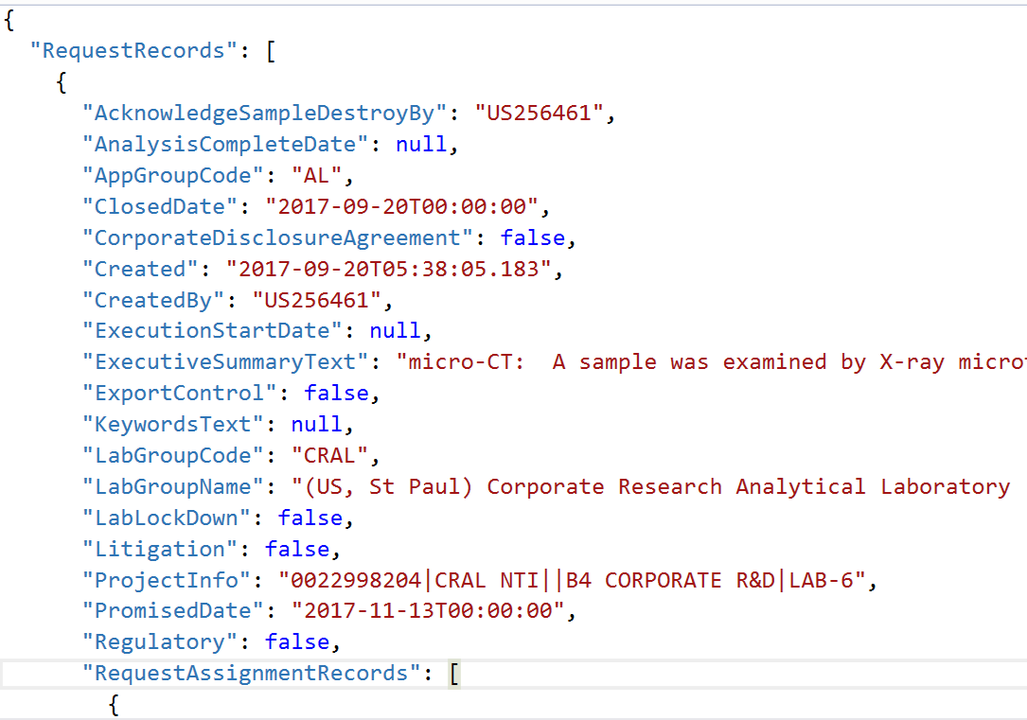


Cloud Based GC-MS Sample Analyzer Data Flow
Compute + Analytics
Data Sources
Data in Motion
Data Storage
Data Access
Data Consumption
CS 498: Cloud Computing Applications- Solution Architecture
Azure AD Integration
Applications capable of calling REST API
Azure Databricks
Azure Python Function
CosmosDB
Azure Python Function
JSON
Jupyter Notebook
Applications capable of consuming REST API
Device
Web Apps

